Slide 1
Redefining the Fundamentals of Cash Forecasting With Artificial Intelligence
Notes:
Redefining the Fundamentals of Cash Forecasting With Artificial Intelligence

Slide 2
Speaker
Tracey Ferguson Knight
Director - Solution Engineering (Treasury)

Slide 3
Agenda
01
Turbulent Times
02
Cash Forecasting
03
Why is Forecasting Challenging?
04
Artificial Intelligence 101
05
Future State of a ‘Digital Treasurer’

Slide 4
Turbulent Times

Slide 5
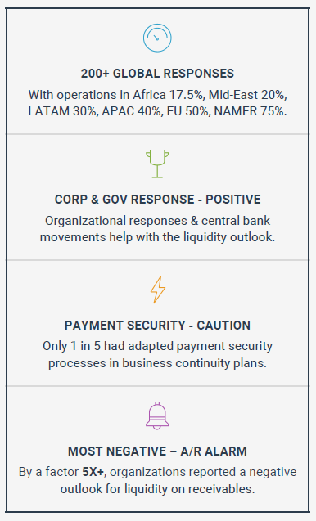
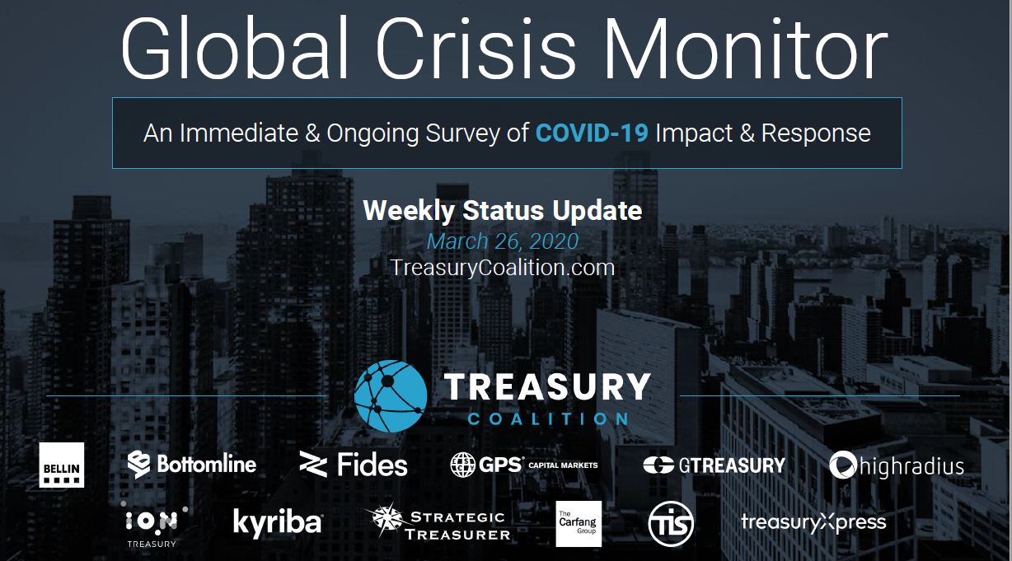
Survey Results – Week 1
Top Level Concerns
Staff Safety Protocols. Ensuring that their staff were safe and following
safety protocols
BCP Completeness. Many models for BCP don’t extend beyond one or two weeks.
Access to Liquidity.
http://www.treasurycoalition.com

Slide 6
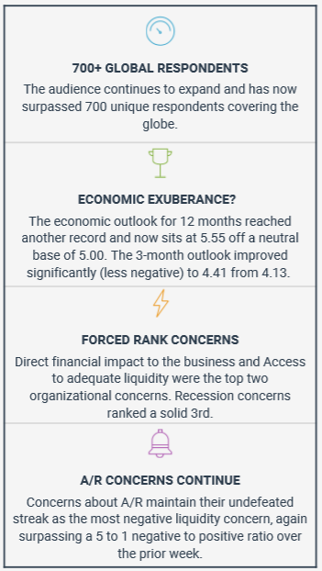
Survey Results – Week 7 (w/e/ May 7)
http://www.treasurycoalition.com

Slide 7
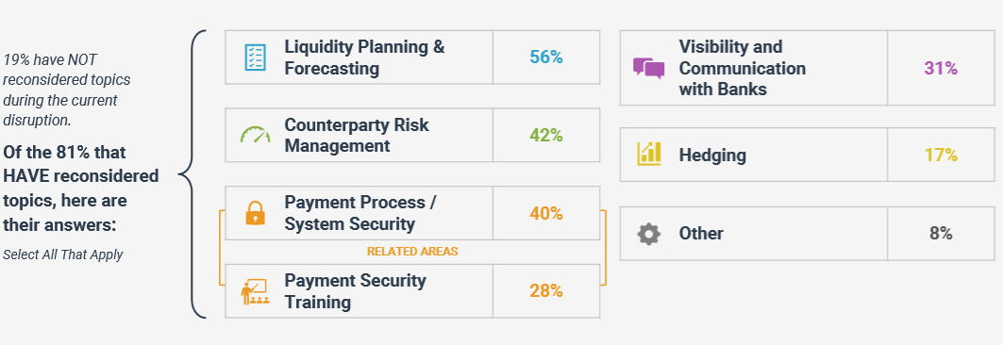
You’ve Considered It Before? Think Again!

Slide 9
Cash Forecasting

Slide 10
Top Priorities For Treasurers
2019 Rank | 2018 Rank | 2017 Rank
1 | 1 | 1
2 | 2 | 2
3 | 5 | 5
4 | 4 | --
5 | 9 | 9
6 | 3 | 6
7 | 10 | --
8 | 8 | 8
9 | 14 | 12
10 | 6 | 3
Cash Forecasting
Financial Risk Management
Treasury Management Systems
Treasury Functional Organization
Balance Sheet Optimization
Treasury Staffing & Skill Nurturing
Bank Service Fees
Operational Efficiency
Cyber Security
Cash Forecasting continues to be the biggest priority for treasurers
Bank Relationship Management
Source: https://www.pwc.com/hu/hu/kiadvanyok/assets/pdf/2019%20PwC%20Global%20Benchmarking%20Survey.pdf
Notes:
TLFK – making better debt/investment decisions
Longer durations
Quarter end cash forecast
Better liquidity planning
Deloitte Survey for 2019
The global corporate treasury survey reveals that many treasurers are comfortable deploying TMS technology across companies ranging drastically in scale. But this is still not yet the case for the newest available technologies, such as robotic process automation (RPA), artificial intelligence (AI), visualization, big data, and blockchain. This is in contrast to the wider finance function in many companies, where the adoption of these new treasury solutions and technologies is happening at an ever-increasing pace. From a Deloitte perspective, we believe that the treasury profession is only at the early stage of this evolution, which could disrupt the way we consider companies using technology in the future. These new technologies are starting to become available within finance organizations. It’s therefore helpful to understand existing areas where these technologies are being implemented. Practical use cases of new technologies are available in all regions. However, a lack of insight into specific treasury solutions combined with unknown costs is cited as the most common challenges for applying these in the treasury function.
Highlights
Liquidity risk management and being a steward for financial risk management remain as the most important CFO mandates.
Inadequate treasury systems infrastructure grew from 30 percent to 47 percent over the past two years.
Visibility of data is now the most challenging area for treasury, up from the second highest challenge in 2017.
The pace of technology adoption by respondents is directly linked to the awareness and perceived need of implementation of new technologies in order to stay ahead in their industry.
The extent to which technology can be used to achieve scalability, reduce cost, and gain a competitive advantage is not yet fully appreciated.
Brexit concerns and the adoption of various international financial reporting standards requirements are cited as the main regulatory challenges facing treasurers.

Slide 11
Technology Adoption Across Markets
Reval survey with Zanders, Treasury Strategies, and Standard Chartered Bank
Notes:
Top priority remains Cash Forecasting with the key objectives remaining same:
Short term liquidity planning.
Half/ full year reporting & visibility
Interest and debt reduction.
Long Term Planning/ Budgeting Purposes

Slide 12
Cash Forecasting Challenges
83%+
Treasurers Consider Forecast Inaccuracy As The Biggest Concern
Inefficient or error-prone technology used to forecast cash
Insufficient time to perform regular and accurate forecasts
Inability to gather and leverage the right datasets
Absence of regular variance analysis to analyse/improve process
Lack of visibility into individual unit level forecasts
Source: Treasury Strategies, 2018 State of the Treasury Profession Survey
Notes:
Highlight the fact that inaccurate forecasts is the biggest problem faced by Treasurers today and the reasons for this are multiple:
Technology is the major culprit as excel sheets remain the biggest impediment to handling large complex volumes of data resulting in unintentional errors creeping in while calculating forecasts, exchanging them with other departments or compiling these multiple forecasts into a single consolidated forecast.
Second is the amount time of dedicated to actual forecast calculating or modelling. This is because time often gets lost in low value tasks such as data gathering, cleansing and communication.
Even with data, most people rely on ready to use data such as bank data or FP&A data while more richer data such as open AR, AP from ERP are not leveraged since there isn’t again, the technological inadequacy to handle it and also the unfamiliarity.
With insufficient time to dedicate to forecasting itself, hardly any time is spent on checking the data for variance. We found that less than 20% team actually perform variance analysis and those who do only perform it very infrequently.
There is also the problem of being unable to delve deep into a forecast received from a unit or a department due to communication and time constraints.

Slide 13
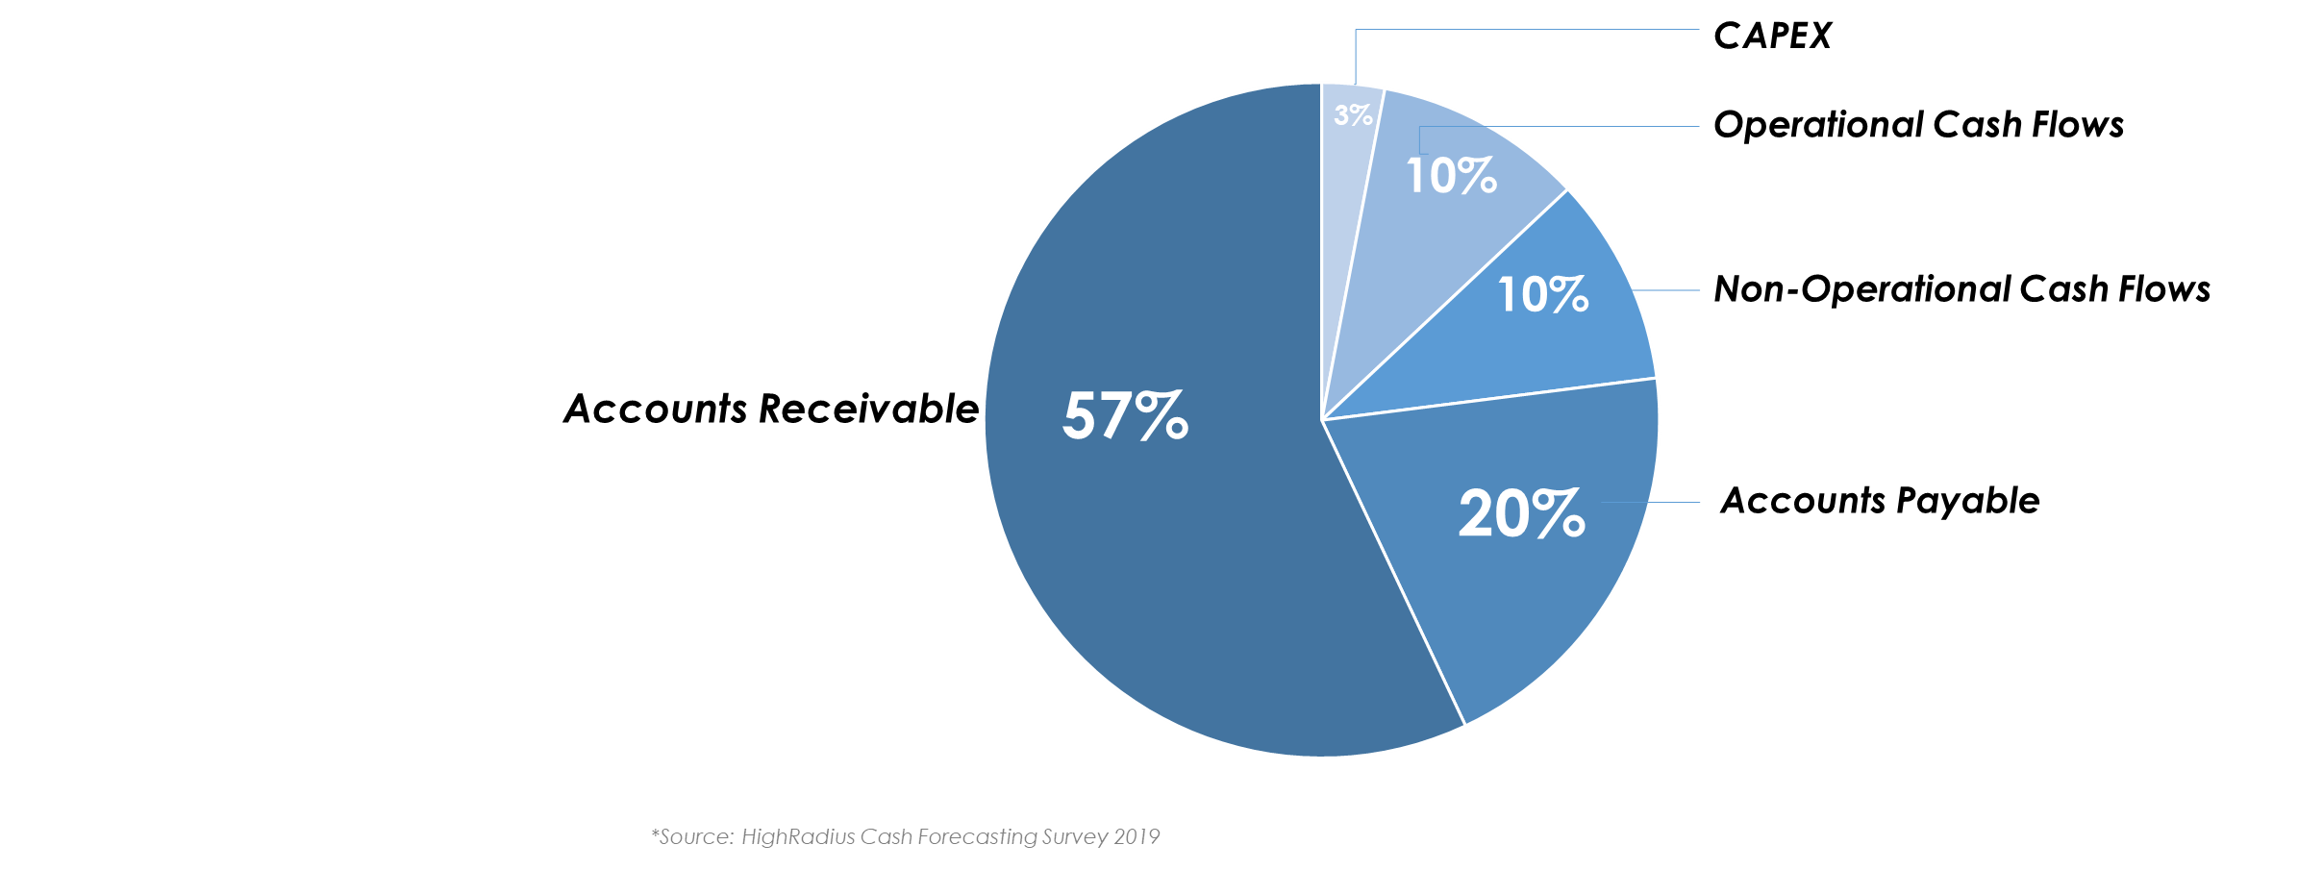
Toughest Cash Flow Categories To Forecast
Notes:
Our interviews with more than 150 Treasury professionals spanning across 100+ Fortune 1000 companies have revealed the following as the most toughest cash flow categories to forecast.

Slide 14
Why is forecasting challenging?
Notes:
So why do treasurers find forecasting such a challenge

Slide 15
The Average Days to Pay (ADP) Approach
(
)
Predicted Payment
Date
Invoice
Date
Average Days
to Pay (ADP)
Notes:
AR team collectors are the basic starting point and they estimate the payment date of an invoice using this formula.

Slide 16
Illustration of the ADP approach
Predicted Payment
Date
Invoice
Date
Average Days
To Pay (ADP)
37
Customer A | 12-Sep-2019
Customer A | 06-Aug-2019
Customer B | 16-Sep-2019
Customer B | 10-Aug-2019
days
Customer C | 21-Sep-2019
Customer C | 15-Aug-2019
Notes:
Applying a single average ADP value to all customers irrespective of their behavior

Slide 17
Illustration of the ADP approach
?
Predicted Payment
Date
Invoice
Date
Average Days
To Pay (ADP)
37
Customer A | 12-Sep-2019
Customer A | 06-Aug-2019
Customer B | 16-Sep-2019
Customer B | 10-Aug-2019
days
Customer C | 21-Sep-2019
Customer C | 15-Aug-2019
Notes:
But is this the right approach when no 2 customers are the same

Slide 18
Using Customer Specific ADP
Predicted Payment
Date
Invoice
Date
Customer Specific
ADP
Customer A | 02-Sep-2019
Customer A | 06-Aug-2019
27 days
Customer B | 18-Sep-2019
Customer B | 10-Aug-2019
39 days
Customer C | 07-Oct-2019
Customer C | 15-Aug-2019
53 days
Notes:
How about starting to use a customer specific ADP value instead

Slide 19
Using Customer Specific ADP
Predicted Payment
Date
Invoice
Date
Customer Specific
ADP
Customer A | 02-Sep-2019
Customer A | 06-Aug-2019
27 days
Customer B | 18-Sep-2019
Customer B | 10-Aug-2019
39 days
Customer C | 07-Oct-2019
Customer C | 15-Aug-2019
53 days
Notes:
Is customer specific ADP value going to work?
Consider Customer B for example who has an ADP of 39 days.

Slide 20
Incorporating Invoice Amount
If Invoice Amount
> $100,000
ADP
54 days
between $10,000
and $100,000
ADP
40 days
Invoice Amount
If Invoice Amount
< $10,000
ADP
32 days
Notes:
Though the average value 39 days, based on Customer B Invoice Payment History, the value fluctuates based on the invoice amount

Slide 21
Impact On Accuracy Levels
Amount
Customer
Prediction Accuracy
ADP
Customer
Invoice Date
ADP
ADP
Invoice Date
Invoice Date
2
3
4
Number of Variables
Notes:
Similarly, as more variables are factored into the calculation, the accuracy with which the payment date is predicted would increase

Slide 22
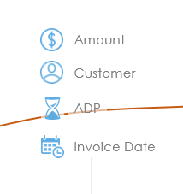
Question For The Audience
Amount
Customer
Prediction Accuracy
ADP
Customer
Invoice Date
ADP
ADP
Invoice Date
?
Invoice Date
Is It Possible To Build A Forecasting Model
Incorporating These 4 Variables In Excel
2
3
4
Number of Variables
Notes:
Now, take the 4 variables into account. Is it possible to build a forecasting model where each of the above 4 variables are taken into effect at an individual customer level?
Ans: Either Yes or No using raise of hands.

Slide 23
What If You Could Add Additional Variables
30+
variables
To predict payment dates with the highest accuracy
Notes:
If you think 4 variables is enough, for the highest accuracy, there are more than 30 variables

Slide 24
What If You Could Add Additional Variables
CUSTOMER OPEN AVERAGE DELAY
PAST INVOICE BASE DUE
CLOSED DELAYED COUNT RATIO
CUSTOMER DELAYED PAYMENTS PERCENT
INVOICE SUM RATIO
DELAY
AVERAGE
PAST AVG DELAY
[12 Months]
PAST CLOSED DELAYED
INVOICE SUM
Invoice Due Date
30+
LAST PAYMENT DATE DIFFERENCE
PAST CLOSED DELAYED INVOICE SUM
[12 Months]
PAST DELAY PAYMENTS PERCENT
[12 Months]
variables
GAP RATIO
DELAY RATIO
PAYMENT TERM LEVEL
AVERAGE DELAY
PAST CLOSED INVOICE COUNT
Payment Frequency
PAST TOTAL AVG DELAY
[6 Months]
BRANCH LEVEL
AVERAGE DELAY
LAST CLEARING DATE
PAST ALL INVOICE COUNT
BATCH SIZE
PAST TOTAL DELAY COUNT
CUSTOMER AVG GAP
CUSTOMER DELAY PAYMENTS PERCENT
CUSTOMER TOTAL AVG DELAY
PAST TOTAL AVERAGE DELAY
CUSTOMER CLOSED AVG DELAY
PAST DELAY PAYMENTS PERCENT
[06 Months]
PAST CLOSED DELAYED INVOICE COUNT
Notes:
Add just a couple more: Invoice Due Date + Payment frequency and the complication of the model increases vastly to an extent that excel no longer is able to handle it.

Slide 25
Artificial Intelligence 101
Notes:
Now, this is where AI comes into the picture.

Slide 26
Artificial Intelligence 101
Accuracy
Select the right variables correlated
to the predicted variable
Invoice
Date
Customer
ADP
Invoice
Amount
Payment
Frequency
V₅
V₆
V₇
V₈
V_{N}
Variables
Notes:
AI can, with great ease and purely on its own, take into consideration multiple variables and then proceed to select only those variables which are correlated to the prediction outcome, which is the payment date in this case.

Slide 27
Artificial Intelligence 101
Identifying best-fit curve to forecast
Amount
Customer ADP
Invoice Date
Notes:
Once this right mix of variables is identified, it then proceeds to build a best-fit curve such that all the variables are encompassed sufficiently.

Slide 28
Consider All Variables
Master List
Invoice Date
Customer Specific ADP
Invoice Amount
Past Invoice Count
Total Open Amount
Gap between payments
Delayed payments percentage
Branch Level Delays
Closed invoice sum
Delayed invoice sum
Due Payment Day Of the Week
Predicted Payment
Date
Past Total Delay Count
60+
Invoice and Customer
Level Variables
Customer Average Open Amount
Closed Invoice Count
Past All Invoice Count
Due Gap For Customer
Notes:
As a en example if we have to predict payment date for AR
We will strt by Looking at all possible variables associated with an invoice
Based on past exp her is a list of more than 60 customer and invoice related variables which can be derived from the datasets at hand including the open AR and previous payments history.

Slide 29
Select The Right Variables
Master List
Correlated Variables
Invoice Date
Invoice Date
Customer Specific ADP
Invoice Amount
Customer Specific ADP
Past Invoice Count
Invoice Amount
Total Open Amount
Total Open Amount
Gap between payments
Delayed payments percentage
Gap between payments
Branch Level Delays
Delayed payments percentage
Closed invoice sum
Delayed invoice sum
Branch Level Delays
Due Payment Day Of the Week
Closed invoice sum
Past Total Delay Count
30+
Correlated
Variables
60+
Invoice and Customer
Level Variables
Due Payment Day Of the Week
Customer Average Open Amount
Closed Invoice Count
Customer Average Open Amount
Past All Invoice Count
Past All Invoice Count
Due Gap For Customer
Notes:
Using correlation analysis to actual payment date, we identify a subset of these variables which suit our case the best

Slide 30
Choosing The Best Fit Curve
Artificial Intelligence
Linear
Regression
Logistical
Regression
Random
Forest
Neural
Networks
Decision Trees
Support
Vector Machine
Gradient
Boosted Trees
K-Nearest
Neighbour
XG
Boost
Light
GBM
Q
Learning
Temporal
Difference
Apriori
Algorithm
Least Angle
Regression
Deep
Adversarial
There are 25+ AI algorithms to pick from
Least Angle
Regression
Elastic
Net
Hopfield
Network
Back
Propagation
Decision Trees
Linear
Regression
Logistical
Regression
Random
Forest
Neural
Networks
Decision Trees
Notes:
As mentioned, there are more than 25 types of algorithms, each suitable for a scenario at hand.

Slide 31
Example AI Algorithm – Linear Regression
Predicted
Payment
Date
=
+
[
]
+
[
Invoice
Amount
Delay
]
Invoice
Date
1
x
Customer
ADP
0.2
x
But as number of correlated variables considered increases,
An Advanced Algorithm Is Needed To Process Them
Notes:
For example, in a two variable case, the Linear Regression algorithm is sufficient

Slide 32
Example AI Algorithm – Decision Tree
Invoice Amount
> $100,000
ADP
54 Days
Invoice Amount
YES
NO
< $10,000
ADP
32 Days
ADP
40 Days
YES
NO
Notes:
Decision Tree of these 3 variables

Slide 33
Choose The Best Fit Curve
Master List
Correlated Variables
Pick The Algorithm
Invoice Date
Invoice Date
Customer Specific ADP
Linear Regression
Invoice Amount
Customer Specific ADP
Logistical Regression
Past Invoice Count
Invoice Amount
Random Forest Classifier
Total Open Amount
Neural Networks
Total Open Amount
Gap between payments
Decision Trees
Delayed payments percentage
Gap between payments
Support Vector Machine
Branch Level Delays
Delayed payments percentage
Gradient Boosted Trees
Closed invoice sum
Delayed invoice sum
Branch Level Delays
K-Nearest Neighbour
Due Payment Day Of the Week
Closed invoice sum
XG-Boost
25+
Artificial Intelligence
Algorithms
Past Total Delay Count
30+
Correlated
Variables
Light GBM
60+
Invoice and Customer
Level Variables
Due Payment Day Of the Week
Customer Average Open Amount
Q-Learning
Closed Invoice Count
Customer Average Open Amount
Temporal Difference
Past All Invoice Count
Past All Invoice Count
Due Gap For Customer
Notes:
RANDOM FOREST CLASSIFIER.

Slide 34
Predicted Payment Date
Master List
Correlated Variables
Pick The Algorithm
Invoice Date
Invoice Date
Customer Specific ADP
Linear Regression
Invoice Amount
Customer Specific ADP
Logistical Regression
Past Invoice Count
Invoice Amount
Random Forest Classifier
Total Open Amount
Neural Networks
Total Open Amount
Gap between payments
Decision Trees
Delayed payments percentage
Gap between payments
Support Vector Machine
Branch Level Delays
Delayed payments percentage
Gradient Boosted Trees
Closed invoice sum
Delayed invoice sum
Branch Level Delays
K-Nearest Neighbour
Due Payment Day Of the Week
Closed invoice sum
XG-Boost
25+
Artificial Intelligence
Algorithms
Past Total Delay Count
30+
Correlated
Variables
Light GBM
60+
Invoice and Customer
Level Variables
Due Payment Day Of the Week
Customer Average Open Amount
Q-Learning
Closed Invoice Count
Customer Average Open Amount
Temporal Difference
Past All Invoice Count
Past All Invoice Count
Due Gap For Customer
Notes:
AI automatically starts by looking at all possible variables associated with an invoice
It then proceeds to select the most apt ones
It then auto-selects & applies the best suited algorithm to see which is best fit curve to predict payment date

Slide 35
Automated forecasting across categories
AUTOMATED
CASH FLOW
FORECAST
OPERATING
CASH FLOWS
NON-OPERATING
CASH FLOWS
A/R
A/P
Payroll
Expenses
CAPEX
Investment
& Debt
Others
Short Term
Short Term
Long Term
Long Term
AI Models
Heuristic Models
Notes:
AI models like these can be applied to all types of cash flows but for simplicity sake and to avoid over-engineering, we applied AI to the most toughest categories, AR + AP.
For others, we apply heuristic models which are also automated models .

Slide 36
Auto-roll up to central treasury
GLOBAL
CASH FLOW
FORECAST
FORECAST
01
FORECAST
03
FORECAST
05
FORECAST
02
FORECAST
06
FORECAST
04
Notes:
Forecasts across multiple cash flow categories are calculated automatically and complied into a single report which is then automatically rolled up to central treasury level

Slide 37
Future State of a ‘Digital Treasurer’

Slide 38
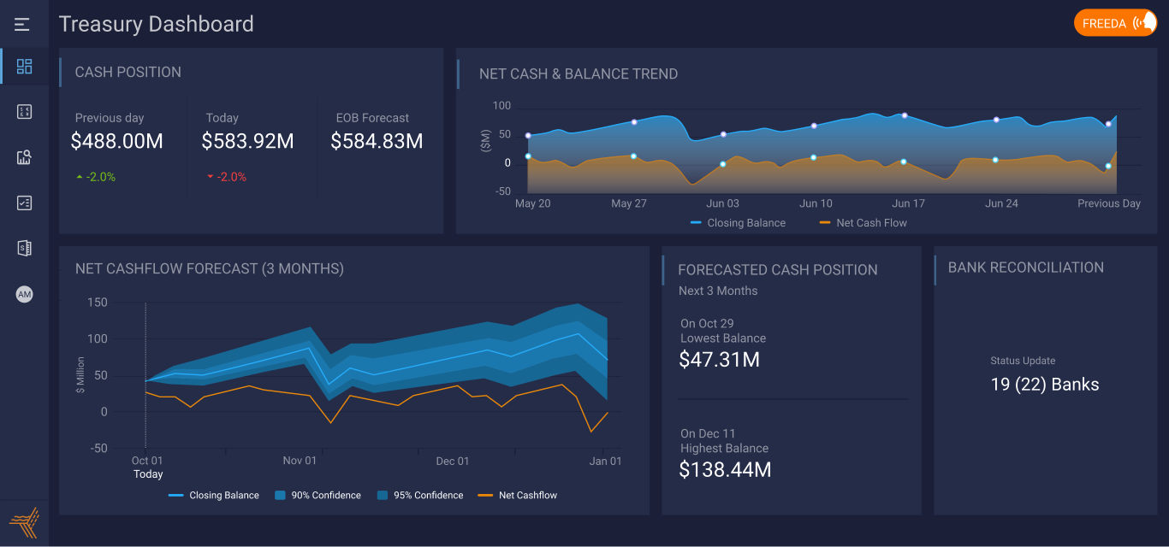
Global Cash Visibility – Current, Past, Future
ABC
Notes:
Home screen of the forecasting solution
You can see the cash position across the globe and can drill down into geography wise or business unit wise or bank account wise by clicking on it.
Top left: Actual cash position of the previous day and its variance from the predicted value, cash position today at 11am & its variation from forecast & on the 3rd box is the forecasted cash position for the end of business hours (5pm today)

Slide 39
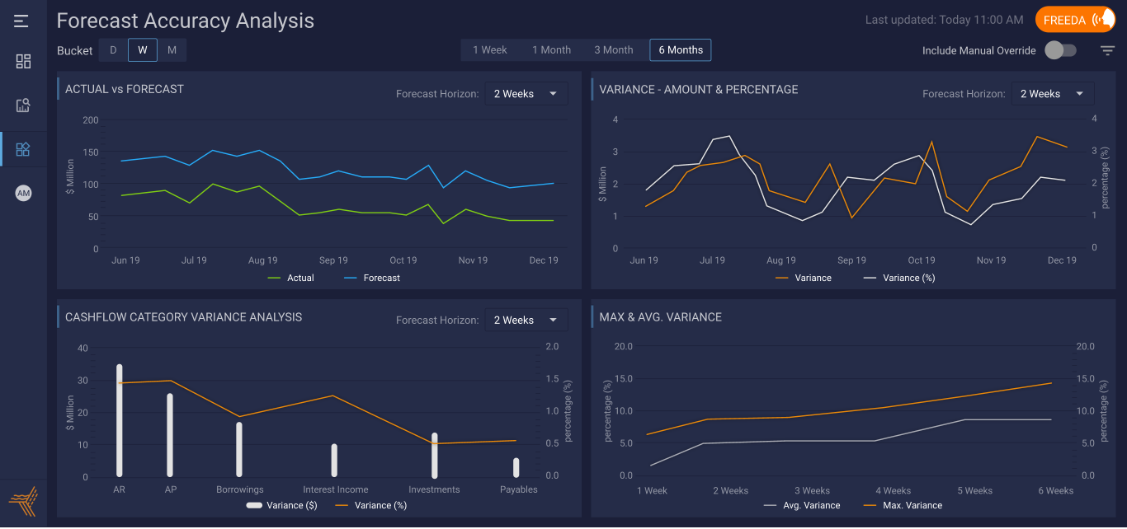
Cash Forecast Variance Analysis
ABC
Notes:
Home screen of the forecasting solution
You can see the cash position across the globe and can drill down into geography wise or business unit wise or bank account wise by clicking on it.
Top left: Actual cash position of the previous day and its variance from the predicted value, cash position today at 11am & its variation from forecast & on the 3rd box is the forecasted cash position for the end of business hours (5pm today)

Slide 40
About HighRadius

Slide 41
Integrated Receivables
Credit
EIPP
Cash App
Deductions
Collections
Treasury Management
Autonomous Systems
Cash Forecasting
Cash Management
Bank Reconciliation
Strategic
Investments
Artificial Intelligence
2019
Cloud Solutions
On-Premise Solutions
2017
Trusted by
200+
Fortune 1000
2014
companies
2010
$1 Trillion +
2006
transactions processed annually
Notes:
HRC was founded in 2006 as on-premise solutions but quickly moved into cloud solutions in 2010 much ahead of the rest of the world. One of the reasons, we stand today as one of the leaders in fintech space is we have always embraced trends ahead of the market. For example, we were using AI much before it was a buzzword and when other companies were still handling only robotic process automation based solutions.
This has helped us partner with finance leaders including Citi, BAML, etc for strategic investments and continuing our tradition, we have now entered the age of Autonomous Systems where professionals interact with their system using advanced touch and voice commands to perform only the most activities such as decision making or authorizations etc while the system works under the hood to perform all other tasks.

Slide 42
Partial List of Customers

Slide 43
Partial List of Customers
950+
Finance Transformation Projects
6 continents | 92 countries
Notes:
TLFK – We have offices in Houston, 2 in India, and London and Amsterdam.

Slide 44
QUESTIONS

Slide 45
Interested in Learning More?
Email: Phillip.Chambers@highradius.com
Or Tracey.Knight@highradius.com

