Slide 1
Rob Phillips
Managing Director, Nasdaq
July 17, 2020

Slide 2
Polling Question #1
How many public companies are listed in the United States?
1,000
10,000
30,000
5,000

Slide 3
Polling Question #2
What is the average age of companies that have IPO’d in the past 5 years?
11 years
7 years
2 years
20 years

Slide 4
The Global Economy + Capital Markets

Slide 5
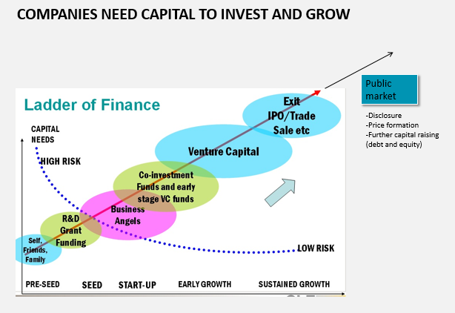

Slide 6
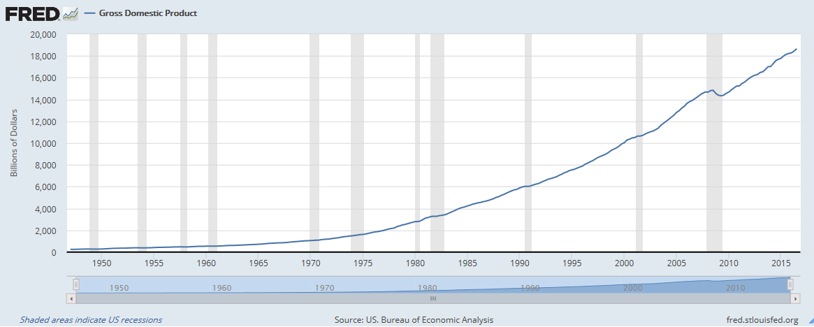
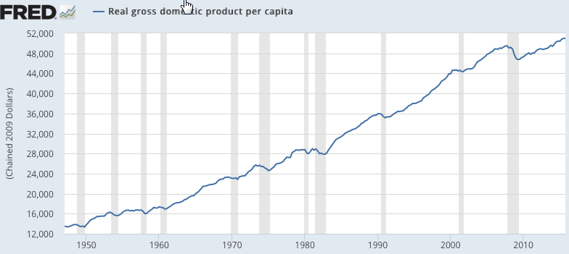
u.s. gross domestic product

Slide 7
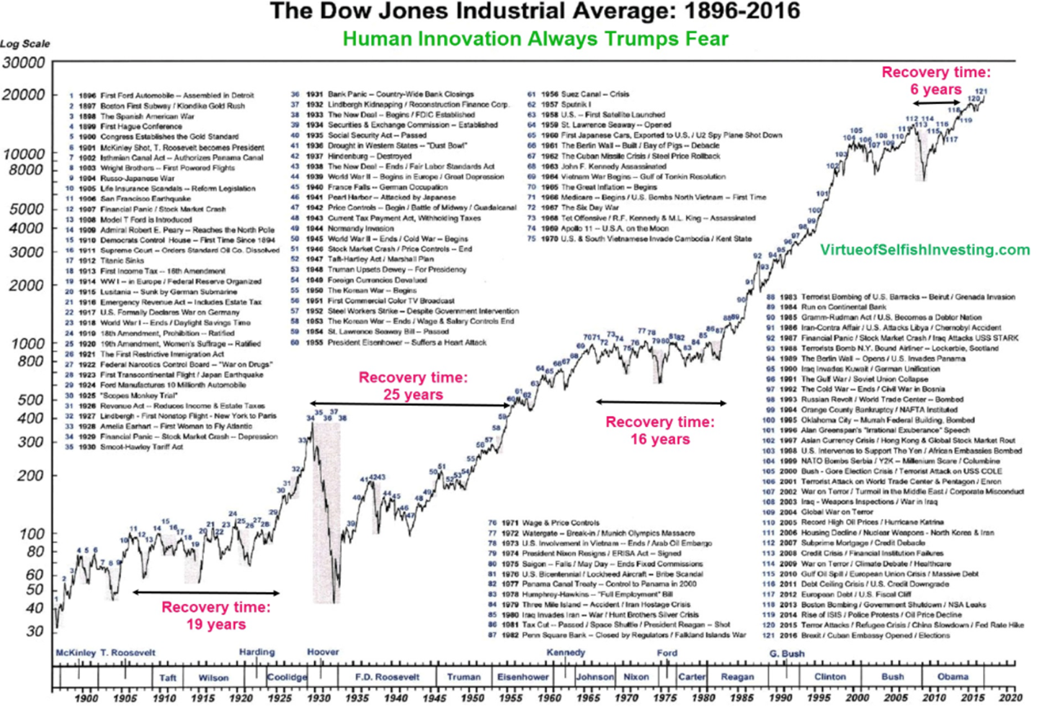

Slide 8
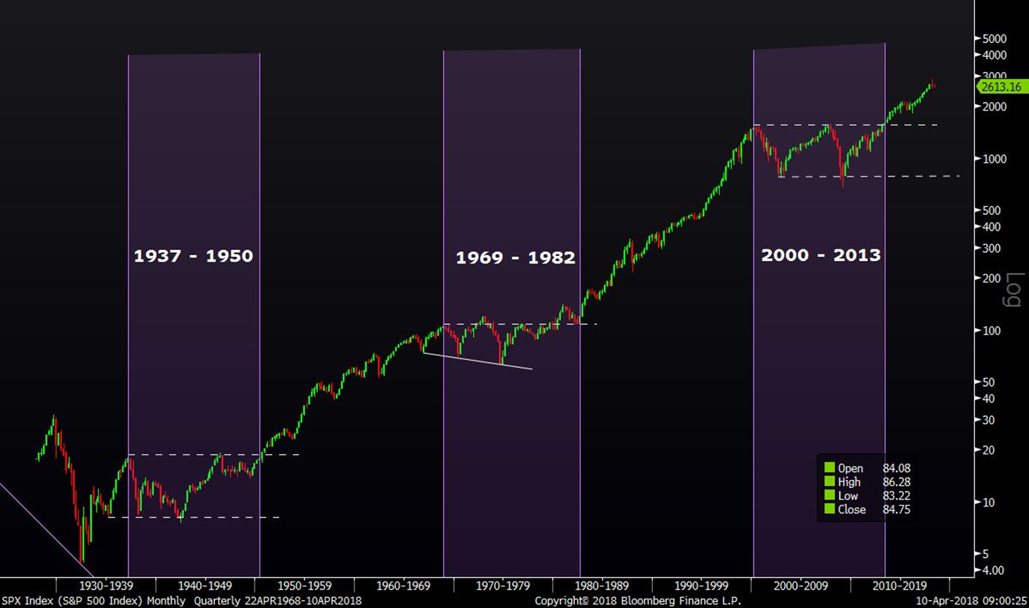

Slide 9
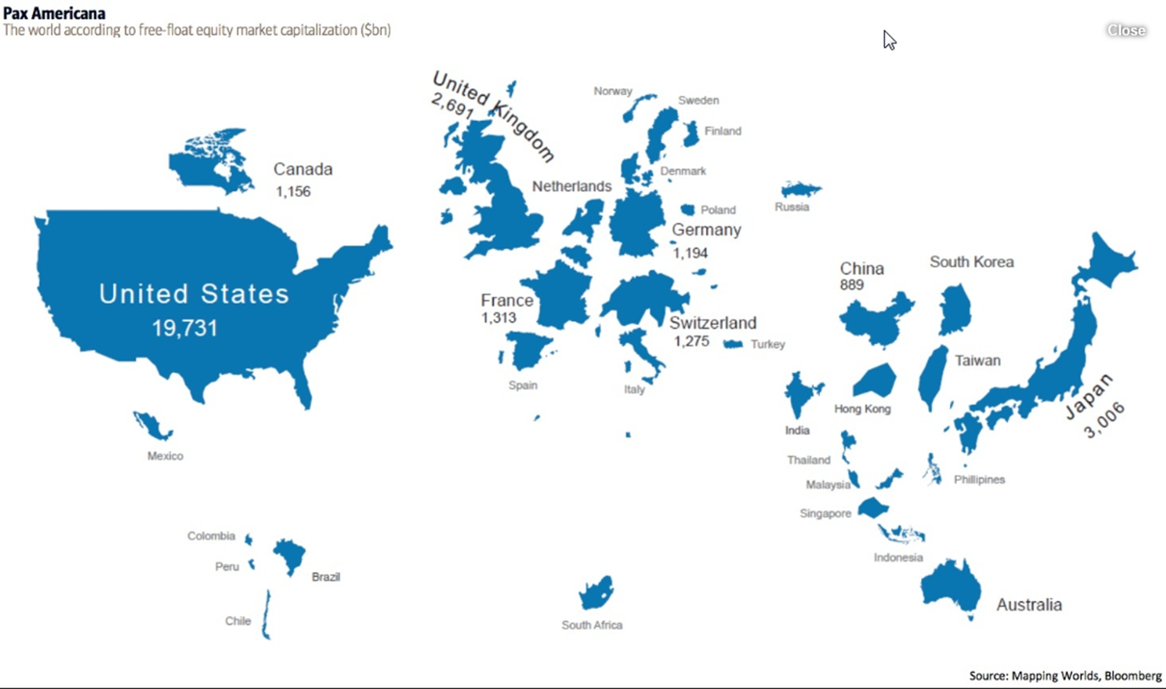
Stock markets: global comparison

Slide 10
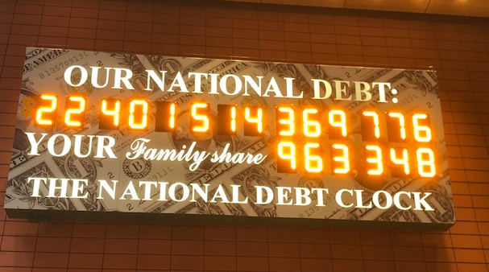
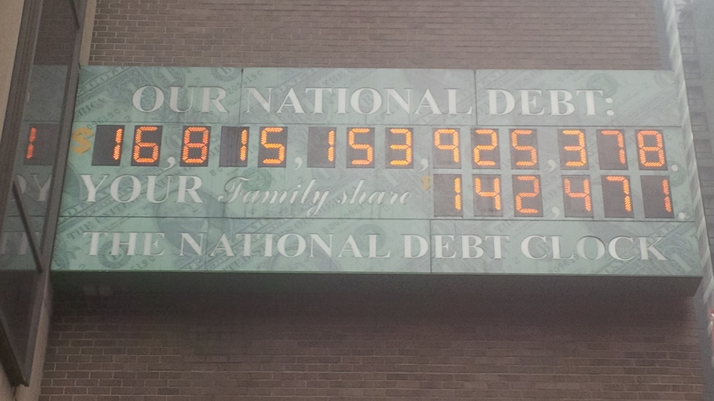
We have challenges
JANUARY 28, 2020
7/13/2020: $26.5 Trillion
$20.6T public debt
$5.9T “Intragovernmental Holdings”
May 14, 2013

Slide 11
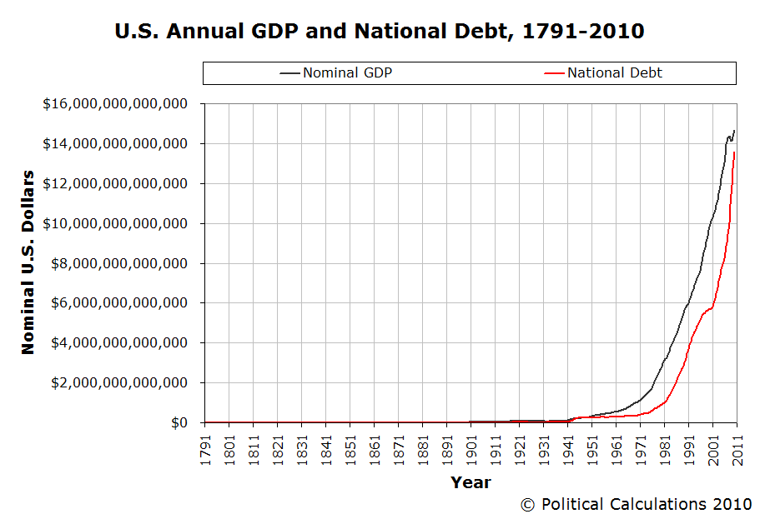

Slide 12
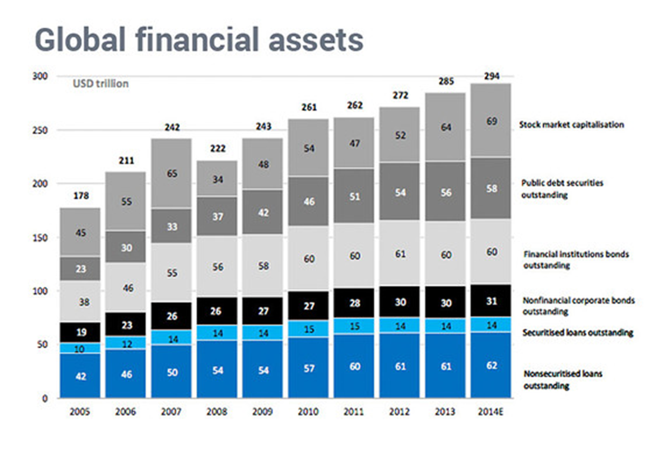
GLOBAL FINANCIAL ASSETS

Slide 13
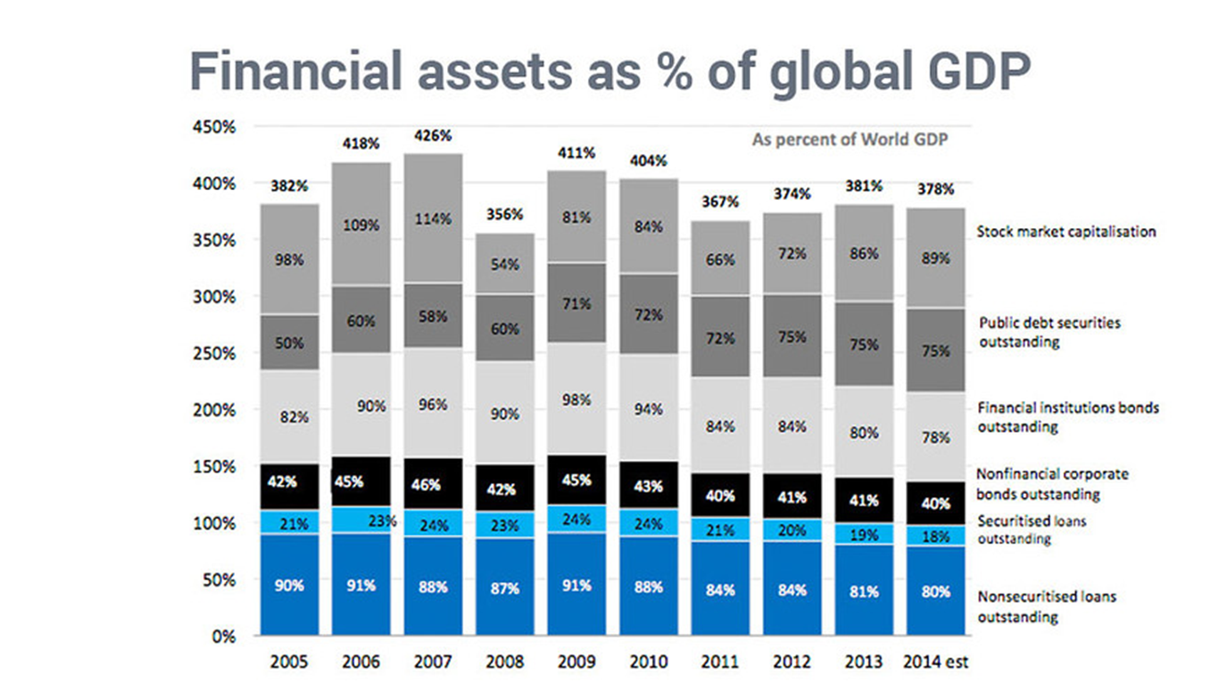
GLOBAL FINANCIAL ASSETS

Slide 14
Polling Question #3
How many stock exchanges are there in the United States?
25
13
3
2

Slide 15
“The Stock Market”

Slide 16
Nasdaq’s Prestigious Network Of Industry Leaders
Top 5
Top 5
Top 8
Largest U.S. Public Companies
Most Admired Brands
Brands That Matter Now
as of February 2019
according to Fortune
according to Fast Company

Slide 17
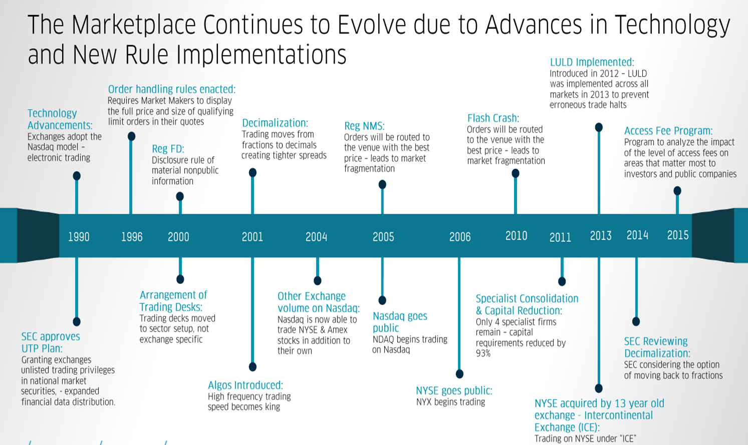

Slide 18
Polling Question #4
For U.S.-listed companies, what is the average percentage of shares traded on the exchange where they are listed?
100%
10%
50%
25%

Slide 20
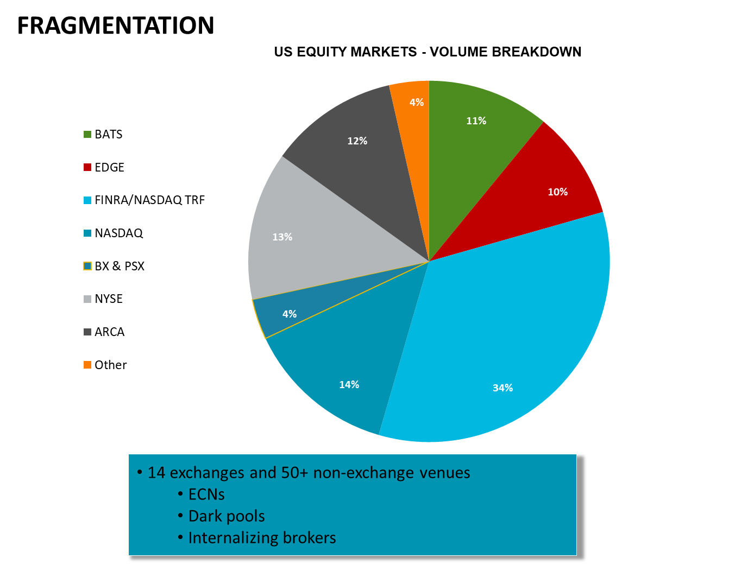

Slide 27
Informed Buyers Choose Nasdaq: $1.6 Trillion in Market Value Has Switched To Nasdaq
Investor Targeting & Surveillance to Drive Valuation
High Impact Visibility & Branding Acceleration
Index Inclusion Opportunities
Lower Cost of Listing
Why Companies Switch to Nasdaq
$1.6T
$1.37T
$1.2T
NDAQ
$862B
NYSE
$827B
$767B
$519B
$586B
$446B
$462B
$462B
$384B
$371B
$378B
$392B
$398B
$174B
$217B
$128B
$51B
\\

Slide 28
“Nasdaq”

Slide 29
(Williams ‘91)

Slide 31
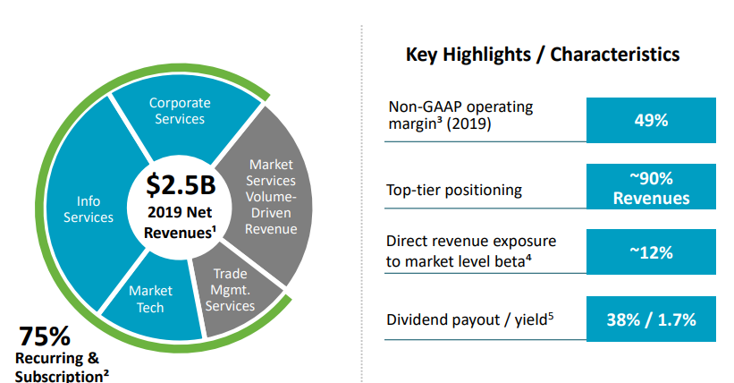

Slide 33
“Don’t argue with results” – Bob Phillips
(Williams ‘91)

Slide 34
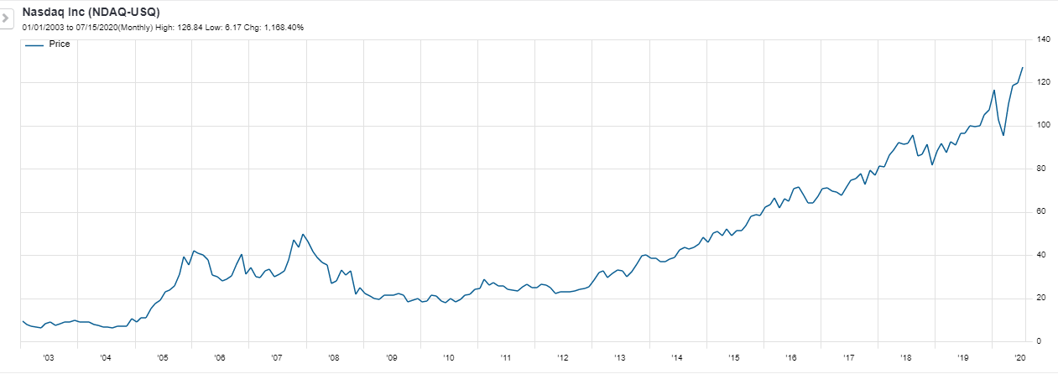
(Williams ‘91)

Slide 35
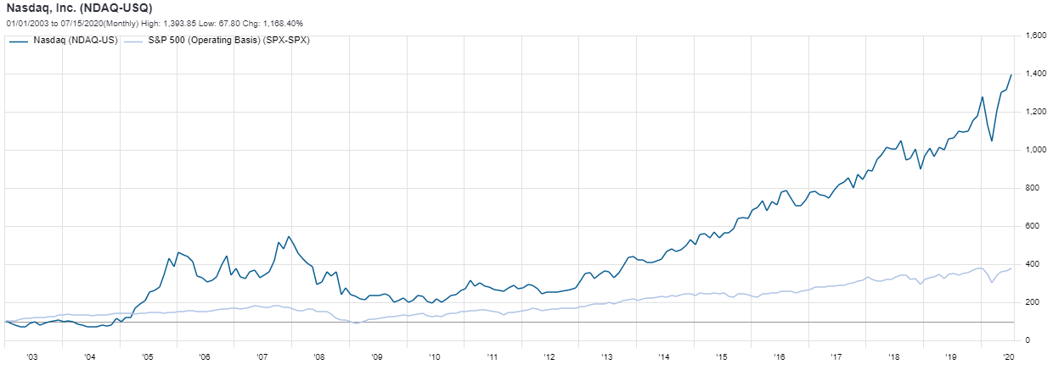
(Williams ‘91)

Slide 36
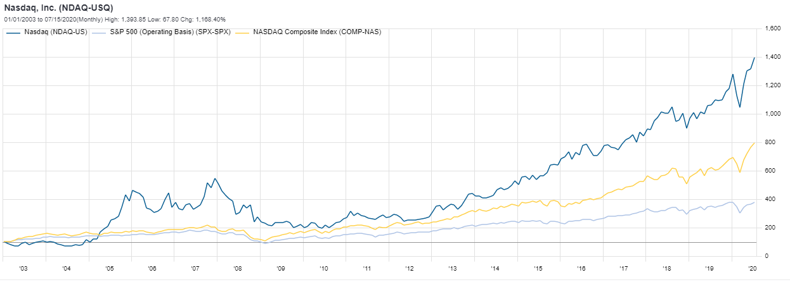
(Williams ‘91)

